Slide 1
Mathematical Optimization in Python
Dan A. Rosa de Jesús
Electrical and Computer Engineering Ph.D. Student University of Texas at El Paso
Applied Statistics and Computational Modeling Group National Security Directorate
GEM Fellowship
August 14, 2019.
Notes:
Stock Image: Abstract Data Visualization Grid

Slide 2
Agenda
Introduction
Optimization Problem
Types of Optimization Problems
Linear Programming
Nonlinear Programming
Evolutionary Computing
Conclusion

Slide 3
Introduction
Mathematical optimization or mathematical programming is the selection of the best element, with regard to some criterion, from some set of available alternatives.
Optimization problems arise in many quantitative disciplines including:
Computer science
Engineering
Operations research
Economics

Slide 4
Optimization Problem
Mathematically speaking, an optimization problem can be defined as:
Given a function f from a set A, look for an element x₀ in A such that f(x₀) ≤ f(x) or such that f(x₀) ≥ f(x), for all x in A.
The first case is called minimization and the second maximization.
Note: f(x₀) ≥ f(x) ⬄ -f(x₀) ≤ -f(x)
Optimization problems can have many objective functions and many constraints.
arg min x² + 1
subject to: x > 1
Objective function f
Constraint on x

Slide 5
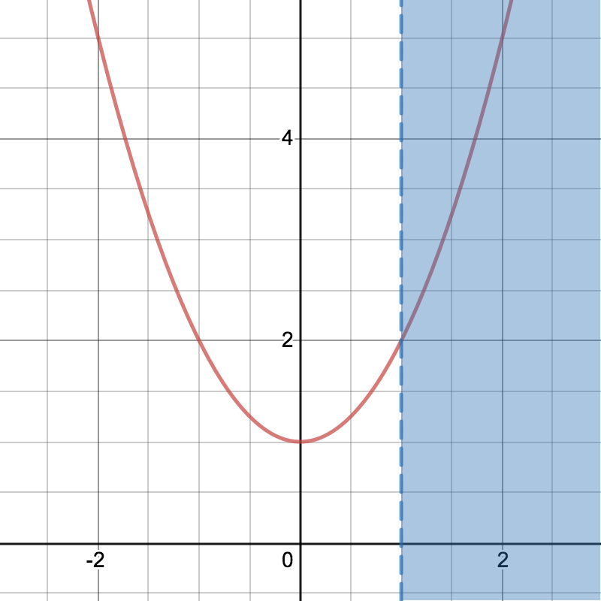
Optimization Problem (Cont.)
arg min x² + 1
subject to: x > 1
Objective function f
Constraint on x
x² + 1
FR
Mathematically
These define the feasible region.
x > 1
It is easy to verify that the solution to this “trivial” optimization problem is x = 1⁺.

Slide 6
Some Types of Optimization Problems
Optimization Problem
Convex
Non-convex
Linear Programming
Nonlinear Programming
Nonlinear
Platypus
Scipy
Pulp
A function is convex if a line segment drawn from any point (x, f(x)) to another point (y, f(y)) lies on or above the graph of f.

Slide 7
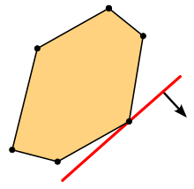
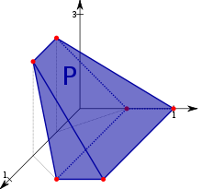
Lineal Programming
Linear programming is a method to achieve the best outcome in a mathematical model with objectives and constraints represented by linear relationships.
arg max c^{T}x
subject to: Ax ≤ b
x ≥ 0

Slide 8
Use case 1: LP Optimization Problem
Suppose you are a mechanic and your goal is to make cars run faster. The more cars you are able make faster, the better. Your secret behind making cars fasters is 2 gas additives, each of which uses special compounds. To create one unit of additive 1, you need 3.1 units of compound A and 2.4 units of compound B. Similarly, to create one unit of additive 2, you need 4.8 and 1 units of compound A and B, respectively. Now additive 1 can make a car faster by 7.5 speed units and additive 2 by 5.2. Furthermore, you only have 15 and 5 units of compound A and B at your disposal.
The question is, how much of each additive will you create to maximize the speed of the next car?

Slide 9
Use case 1: LP Optimization Problem (Cont.)
a₂ ≥ 0
arg max 7.5 a₁ + 5.2 a₂
subject to: 3.1 a₁ + 4.8 a₂ ≤ 15
2.4 a₁ + a₂ ≤ 5
a₁ ≥ 0
a₂ ≥ 0
7.5 a₁ + 5.2 a₂
solution
FR
a₁≥ 0
3.1 a₁ + 4.8 a₂ ≤ 15
Solution: a₁ = 1.07, a₂ = 2.43
Speed can be maximized by 20.68 units!
2.4 a₁ + a₂ ≤ 5

Slide 10
Use case 1: LP Optimization Problem (Cont.)
What would happen if we change the speed
coefficients of the objective?
a₂ ≥ 0
arg max 1.2 a₁ + 2.1 a₂
subject to: 3.1 a₁ + 4.8 a₂ ≤ 15
2.4 a₁ + a₂ ≤ 5
a₁ ≥ 0
a₂ ≥ 0
7.5 a₁ + 5.2 a₂
solution
FR
a₁≥ 0
3.1 a₁ + 4.8 a₂ ≤ 15
Solution: a₁ = 0.00, a₂ = 3.12
Speed can be maximized by 6.56 units!
2.4 a₁ + a₂ ≤ 5

Slide 11
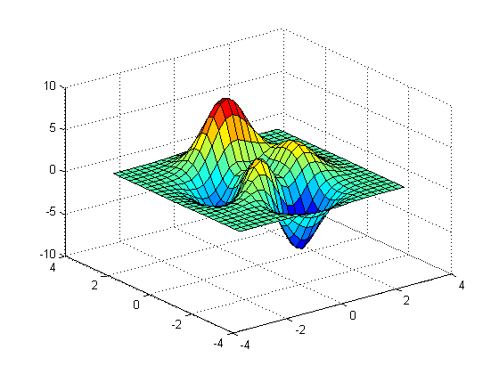
Nonlinear Programming
Nonlinear programming is the process of solving an optimization problem where some of the constraints or the objective function are nonlinear.
arg min f(x)
subject to: g(x) ≤ 0
h(x) = 0

Slide 12
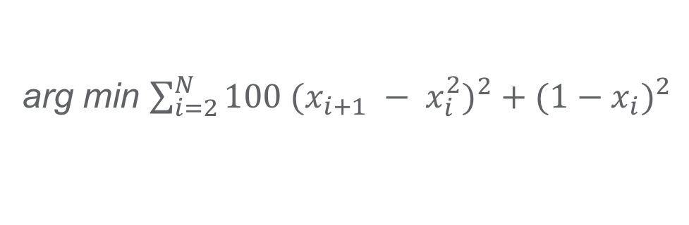
Use case 2: NLP Optimization Problem
Let us consider the problem of minimizing the Rosenbrock function of variables:
The Rosenbrock function is used as a performance test problem for optimization algorithms.
The minimum value of this function is 0 which is achieved when x_{i} = 1.
arg min $\sum_{i=2}^{N}{100 {(x_{i+1} − x_{i}^{2})}^{2} + {(1−x_{i})}^{2}}$
Rosenbrock function
Solution

Slide 13
Evolutionary Computing
Evolutionary computation is a family of algorithms for global optimization inspired by biological evolution.
Genetic Algorithms
Initialization: the population size and position is set within the FR.
Selection: a portion of the existing population is selected to breed a new generation
Genetic operators: i.e. crossover and mutation
Termination: if a solution satisfies a minimum criteria, the number of generations is reached, or the combinations of these two.
Crossover
Mutation
Parent A
Parent B
Offspring
Parent
Offspring
+
=
=>

Slide 14
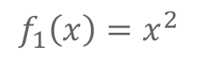
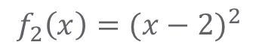
Use case 3: Evolutionary Computing
Let us consider the problem of minimizing the Schaffer function:
The Schaffer function is also used as a performance test problem for optimization algorithms.
$$f_{1}\left(x\right)=x^{2}$$
arg min
$$f_{2}\left(x\right)={(x−2)}^{2}$$

Slide 15
Conclusion
We discussed how to formulate and model optimization problems:
Convex and nonconvex
Linear
Single objective constrained
Multi-objective unconstrained
Nonlinear
Single objective unconstrained
There are several Python optimization packages:
PuLP: A linear programming Python API
Scipy: A Python open-source software for mathematics
Platypus: A framework for evolutionary computing in Python
The use of these packages depends on the nature of the problem at hand.

Slide 16
Links
https://www.coin-or.org/PuLP
https://docs.scipy.org/doc/scipy/reference/optimize.html
https://platypus.readthedocs.io/en/latest/

